Slide 1
Capstone project
The Battle of neighborhood - Week 1 and 2
- Liverpool properties analyses -

Slide 2
Introduction
Business problem
UK is in process of exiting EU, the real estate market is in shake and unpredictable But now, UK facing another problem and that is global pandemic situation In order to assist home buyers in Liverpool to make a good decision of purchase a suitable real estate, we gonna use our data science powers. We gonna solve this problem by custering Liverpool neighborhoods so we can recommend venues and the current average price of real estate where buyers can make investment.

Slide 3
Data
We will use data for Liverpool properties from UK’s government land registry website https://landregistry.data.gov.uk/ The data will be in .csv format. We will also use data from FourSquare api interface, combine two sets of data and arrange data into dataframes and use it for visualization.
After that we will be able to easily recommend profitable real estate for investments.

Slide 4
Methodology
In this section we will gave 4 stages:
Collect data
Inspection data
Explore and understand data
Modeling data

Slide 5
Solution
Solution to this problem is to create clusters of Liverpool’s neighborhood in order to recommend venues and homes average prices so home buyers can make good investments.

Slide 6
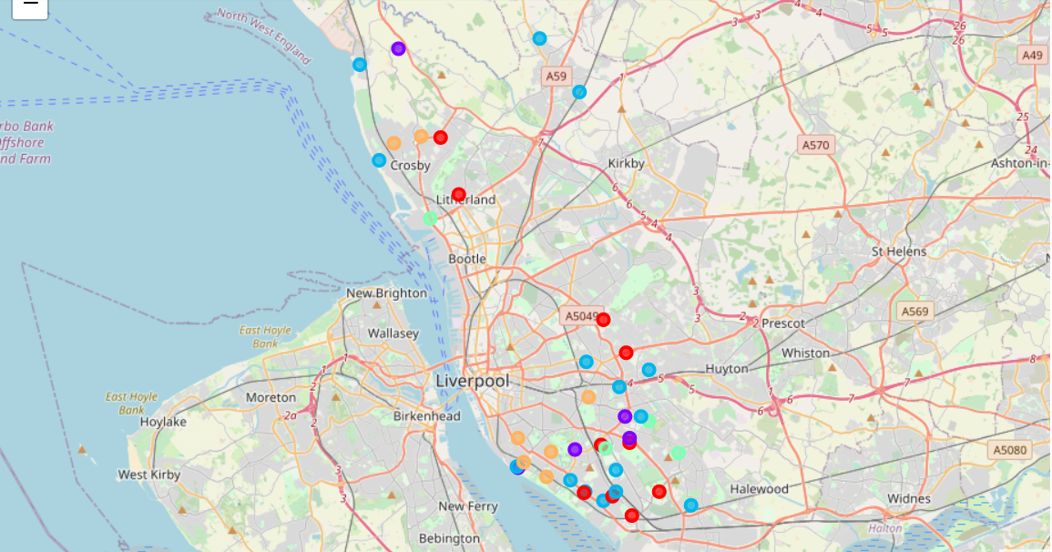
Results
K-means clustering
Results on the map are divided in 5 clusters from 0 to 4.
For every cluster group we have table with 5 results with average price and 10 most common venues.

Slide 7
Discussion
Cluster 0 (red) – have low average price of homes and lots of cafes
Cluster 1 (blue) – have highest average price of homes and have lots of markets and shops
Cluster 2 (cyan) – have the lowest average price of homes and have lots of restaurants and public transportation options
Cluster 3 (green) – have the high average price of homes have lots of restaurants and shops
Cluster 4 (yellow) – have lower average price have lots of pubs and fast food places.

Slide 8
Conclusion
Venues diversity in Liverpool neighborhoods and price of homes are great at the moment.
Cluster 2 and 4 are best place for young people and students
Cluster 0,1 and 3 are best for families.
Most of properties are situated in south and east part of Liverpool

